Slide 1
WOUND HEALING

Slide 2
Anatomy of Skin
Epidermis:
      composed of several thin layers:
        stratum basale, stratum spinosum, stratum
        granulosum, stratum lucidum, stratum corneum
      the several thin layers of the epidermis contain the following:
        a) melanocytes, which produce melanin, a pigment that
        gives skin its color and protects it from the damaging
        effects of ultraviolet radiation.
        b) keratinocytes, which produce keratin, a water
        Repellent protein that gives the epidermis its tough,
        Protective quality.

Slide 3
Anatomy of Skin
Dermis:
      composed of a thick layer of skin that contains collagen and elastic fibers, nerve fibers, blood vessels, sweat and sebaceous glands, and hair follicles.
Subcutaneous Tissue:
      composed of a fatty layer of skin that contains blood vessels, nerves, lymph, and loose connective tissue filled with fat cells

Slide 4
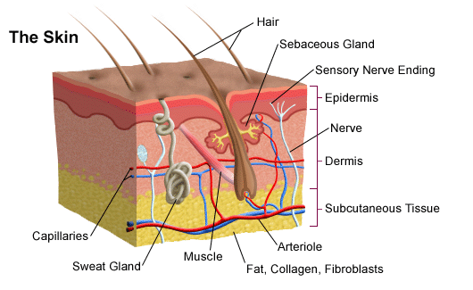

Slide 5
Function of Integument
Protection:
      intact skin prevents invasion of the body by bacteria
Thermoregulation:
    intact skin facilitates heat loss and cools the body when necessary through the following processes:
      production of perspiration which assists in cooling the body through evaporation
      production of vasodilatation which assists in facilitating heat loss from the body through radiation and conduction
      production of vasoconstriction which assists in preventing heat loss from the body through radiation and conduction

Slide 6
Function of Integument
Fluid and Electrolyte Balance:
      intact skin prevents the escape of water and electrolytes from the body
Vitamin D Synthesis
Sensation
Psychosocial

Slide 7
Classification of Wounds
1) Clean Wound:
      Operative incisional wounds that follow nonpenetrating (blunt) trauma.
2) Clean/Contaminated Wound:
      uninfected wounds in which no inflammation is encountered but the respiratory, gastrointestinal, genital, and/or urinary tract have been entered.
3) Contaminated Wound:
      open, traumatic wounds or surgical wounds involving a major break in sterile technique that show evidence of inflammation.
4) Infected Wound:
      old, traumatic wounds containing dead tissue and wounds with evidence of a clinical infection (e.g., purulent drainage).

Slide 8
Classification of Wounds Closure
Healing by Primary Intention:
      All Layers are closed. The incision that heals by first intention does so in a minimum amount of time, with no separation of the wound edges, and with minimal scar formation.
Healing by Secondary Intention:
      Deep layers are closed but superficial layers are left to heal from the inside out. Healing by second is appropriate in cases of infection, excessive trauma, tissue loss, or imprecise approximation of tissue.
Healing by Tertiary Intention:
      Also referred to as delayed primary closure.

Slide 9
Wound Healing
Occurs in three phases

Slide 10
Inflammatory phase
  Inflammation occurs when the damaged endothelial cells release cytokines that increase expression of integrands in circulating lymphocytes.
  Histamine, serotonin, and kinins cause vessel contraction (thromboxane), decrease in blood loss, and act as chemotactic factors for neutrophils, the most abundant cells in the initial 24 hour period.

Slide 11
Proliferative phase
  Proliferative phase occurs next, after the neutrophils have removed cellular debris and release further cytokines acting as attracting agents for macrophages.
      Fibroblasts now migrate into the wound, and secrete collagen type III.
      Angiogenesis occurs by 48 hours.
      The secretion of collagen, macrophage remodeling and secretion, and angiogenesis continues for up to 3 weeks.
      The greatest increase in wound strength occurs during this phase.

Slide 12
Maturation phase
  Maturation phase is the final phase and starts from the 3rd week and continues for up to 9-12 months.
  This is where collagen III is converted to collagen I, and the tensile strength continues to increase up to 80% of normal tissue.

Slide 13
What are the stages of wound healing?
blood clotting (hemostasis),
inflammation,
tissue growth (cell proliferation),
tissue remodeling (maturation and cell differentiation).
Blood clotting may be considered to be part of the inflammation stage instead of a separate stage.

Slide 14
Fetal Wound Healing
  Fetal wound healing proceeds without fibrosis or scar formation in contrast to adult wound healing. The mechanisms responsible for this remarkable process are mediated in part through a fetal wound extracellular matrix rich in hyaluronic acid (HA).
  Proposed contributing factors to scarless healing in fetal wounds are the presence of fewer neutrophils and more monocytes during the inflammatory period, different concentrations of cytokines, and a greater proportion of type III collagen in contrast to adult wounds.

Slide 15
Questions?

